Slide 1

Cryptography Fundamentals

Slide 2
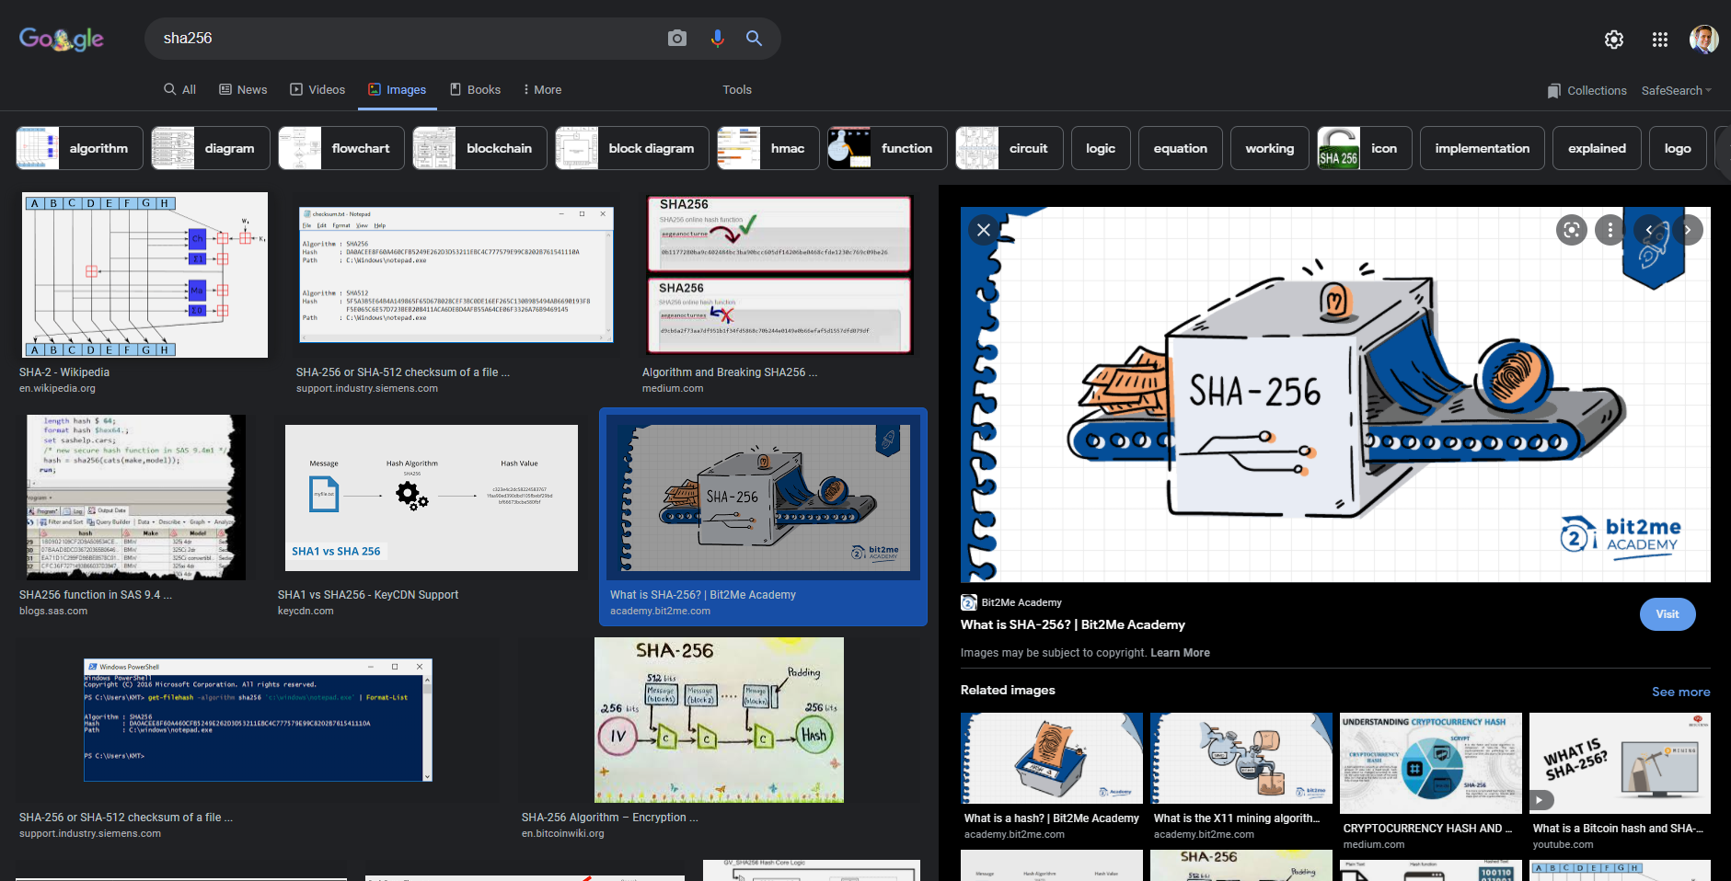

Slide 3
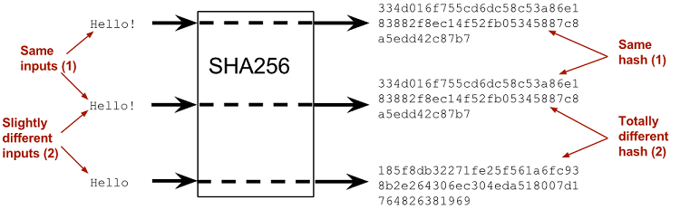

Slide 4
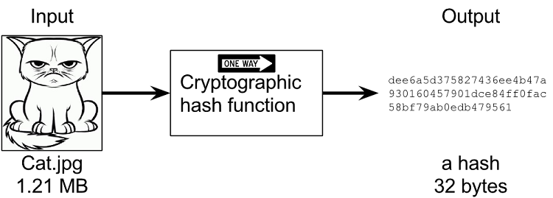
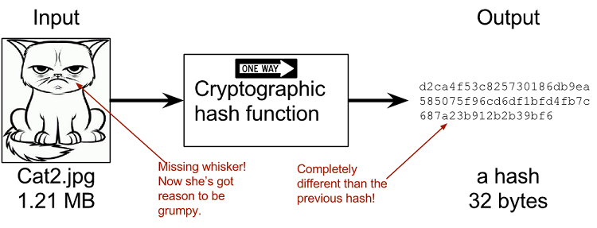

Slide 5




4fd7a192486a0ec37f46baf01b31c6776c6ebef1d736632919bfc5054a5796c1

Slide 6
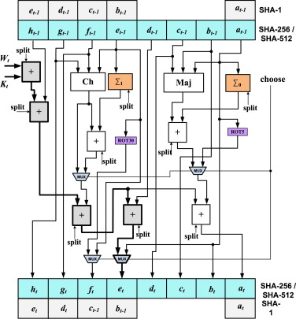
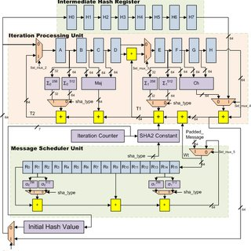

Slide 7
2
256
115 quattuorvigintillion 792 trevigintillion 89 duovigintillion 237 unvigintillion 316 vigintillion 195 novemdecillion 423 octodecillion 570 septendecillion 985 sexdecillion 8 quindecillion 687 quattuordecillion 907 tredecillion 853 duodecillion 269 undecillion 984 decillion 665 nonillion 640 octillion 564 septillion 39 sextillion 457 quintillion 584 quadrillion 7 trillion 913 billion 129 million 639 thousand 936

Slide 8
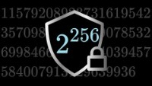
2
256

Slide 9
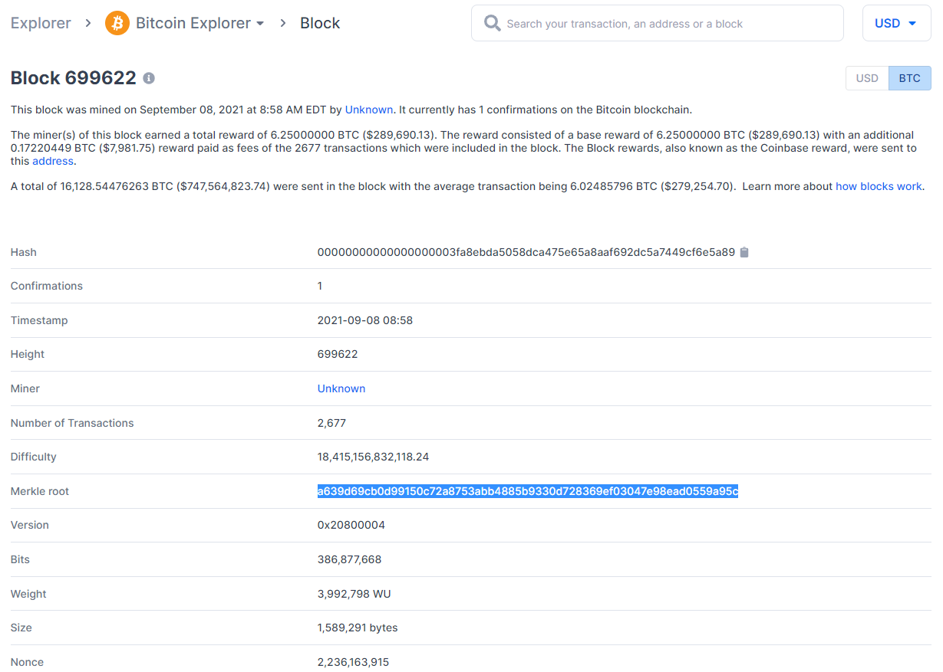

Slide 10


Slide 11
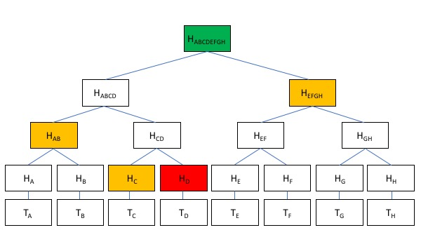
Merkle Trees

Slide 12
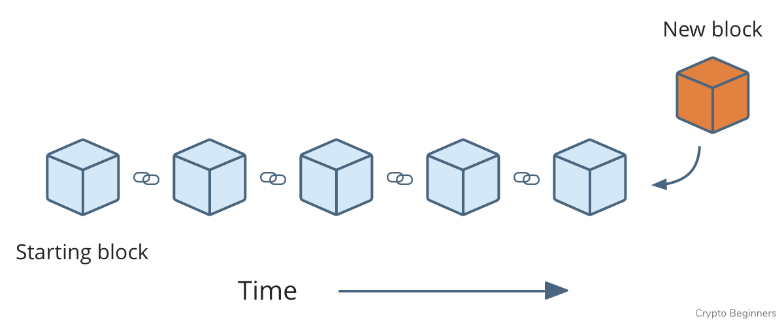
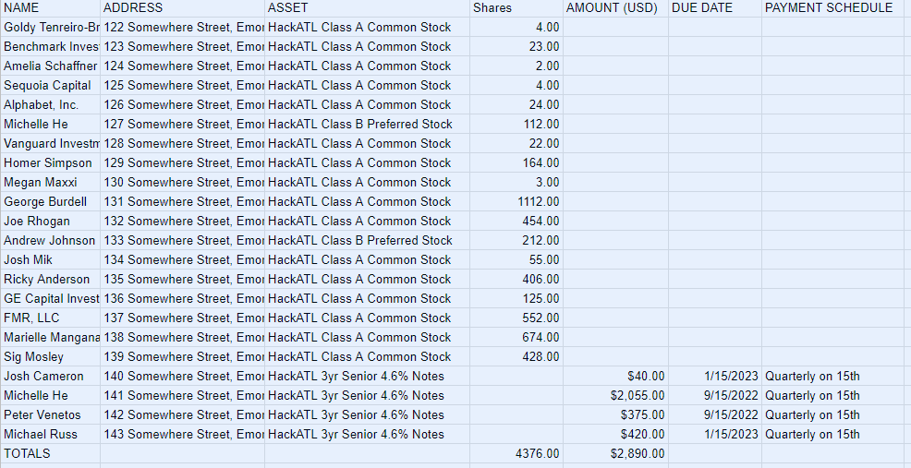

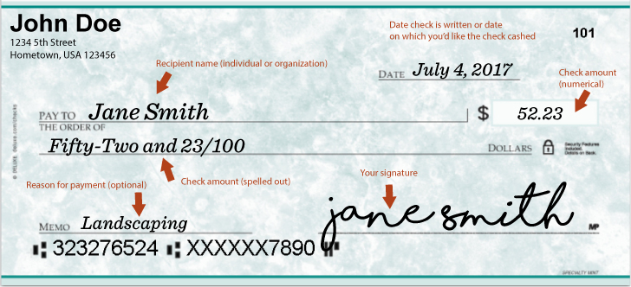

Slide 13
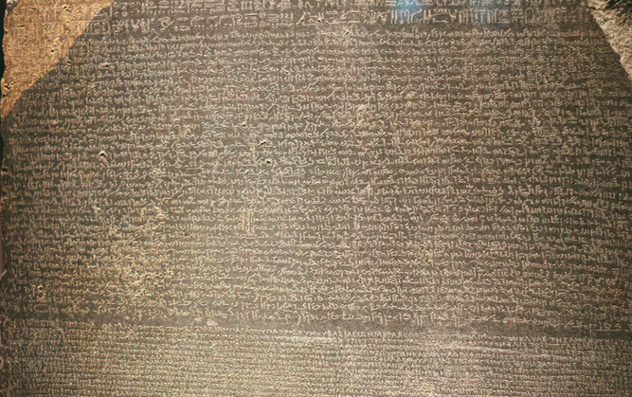
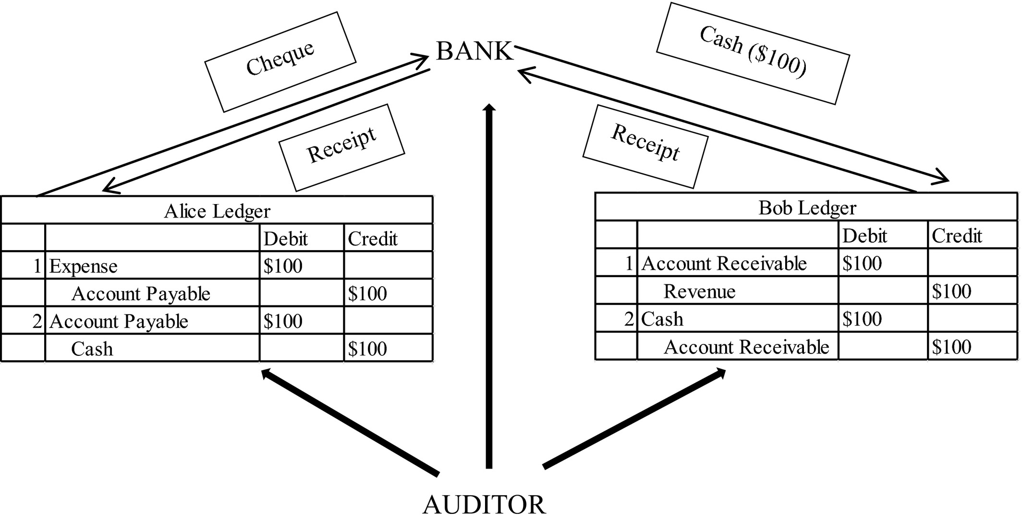

Slide 14
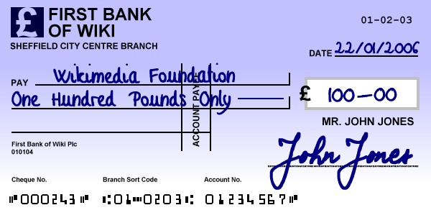

Slide 15
